Slide 2
Meta Prophet
Prophet is a model from Meta / Facebook.
The model allows only one input parameter
The model allows for seasonality and holidays
Neural Prophet may have better results

Slide 3
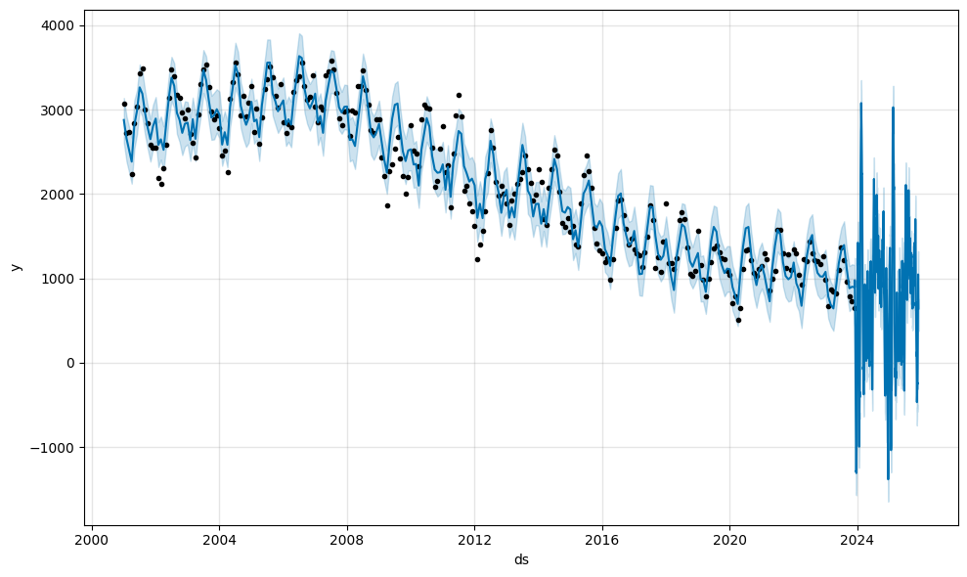
Meta Prophet

Slide 4
Meta Prophet
horizon mse rmse mae
0 37 days 1.093213e+06 1045.568034 827.816340
1 38 days 1.087036e+06 1042.610281 828.718786
2 40 days 1.065286e+06 1032.126874 814.787089
3 41 days 1.059688e+06 1029.411259 811.562895
4 42 days 1.091931e+06 1044.955242 842.449406

